Slide 1
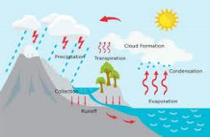
Year 4: Water Cycle Knowledge Mat
Subject Specific Vocabulary |  | Stages of the water cycle |  | Sticky Knowledge about water
water vapour | Water that is in the form of gas. | 1 | The sun heats up rivers, lakes and the sea. | 1 | Water can exist in three forms: liquid (water), solid (ice) or gas (water vapour).
condensation | When water vapour that is around us changes from a gas back to liquid. | 2 | Water evaporates into the air. This is called water vapour.
 |  |  |  | 2 | About 70% of Earth is covered in water.
precipitation | Any watery substance such as rain, water, snow, hail or sleet that falls to Earth. | 3 | The water vapour rises, cools and condenses to water in the form of clouds. | 3 | There are underground reservoirs called aquifers.
evaporation | When liquid changes into gas, usually when it heats up. | 4 | The droplets in the clouds become too heavy and fall as rain, snow or hail. | 4 | Some water in the ground may stay there for thousands of years.
substance | Any solid, liquid, powder or gas is a substance.
 |  | 5 | The rain, snow or hail is then collected in rivers that run off to the sea.
matter | Any solid, liquid or gas that exists in the universe. |  |  | 5 | Water can be used to create electricity through a hydro-electric power station.
lava | Very hot liquid that comes out of a volcano. | 6 | The cycle starts again.
 |  |  |  | 6 | The Nile is 4132 miles long, making it the longest river in the world.
solid | A substance that stays the same shape. Its particles do not move.
liquid | Liquids will flow as they are made up of loosely packed particles. |  |  | 7 | Humans are made up of about 75% water.
gas | Gaseous matter is made up of matter that is so loose it is always moving.
 |  |  |  | 8 | 97% of water is in the oceans (this is salty water) and 2% is in the ice caps, leaving only 1% available for us to drink.

Slide 2
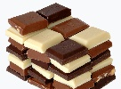
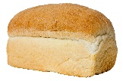
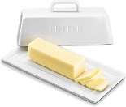
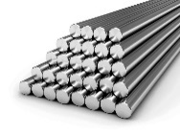
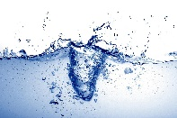
Year 4: States of Matter Mat
Subject Specific Vocabulary |  | What changes state when heated? |  | Sticky Knowledge about states of matter
freeze | A liquid that hardens into a solid by becoming very cold | 1 | chocolate | 1 | Group materials based on their state of matter (solid, liquid, gas
solid | Is sturdy and substantial with particles packed closely together | 2 | bread
 |  |  |  | 2 | Know the temperature at which materials change state
Celsius | A scale of temperature on which water freezes at 0° and boils at 100° | 3 | butter | 3 | Know about and explore how some materials can change state
Fahrenheit | Another way of measuring temperature | 4 | metals | 4 | Know the part played by evaporation and condensation in the water cycle
evaporation | When liquid changes into gas, usually when it heats up | 5 | paper | Additional sticky knowledge
 |  |  |  | 1 | Know what happens to materials such as paper, chocolate, butter, etc when they are heated.
condensation | When water vapour that is around us changes from a gas back to liquid | 6 | water
gas | Gas is a state of matter that we cannot see |  |  | 2 | Know which materials have three states, e.g. gas, liquid and solid.
oxygen | A colourless gas that we need to breath in to stay alive
 |  |  |  | 3 | Know the names of some gases, e.g. oxygen, carbon dioxide
liquid | Is the intermediate between gas and a solid
temperature | The measurement of how hot or cold an object is
Solid Liquid Gas

Slide 3
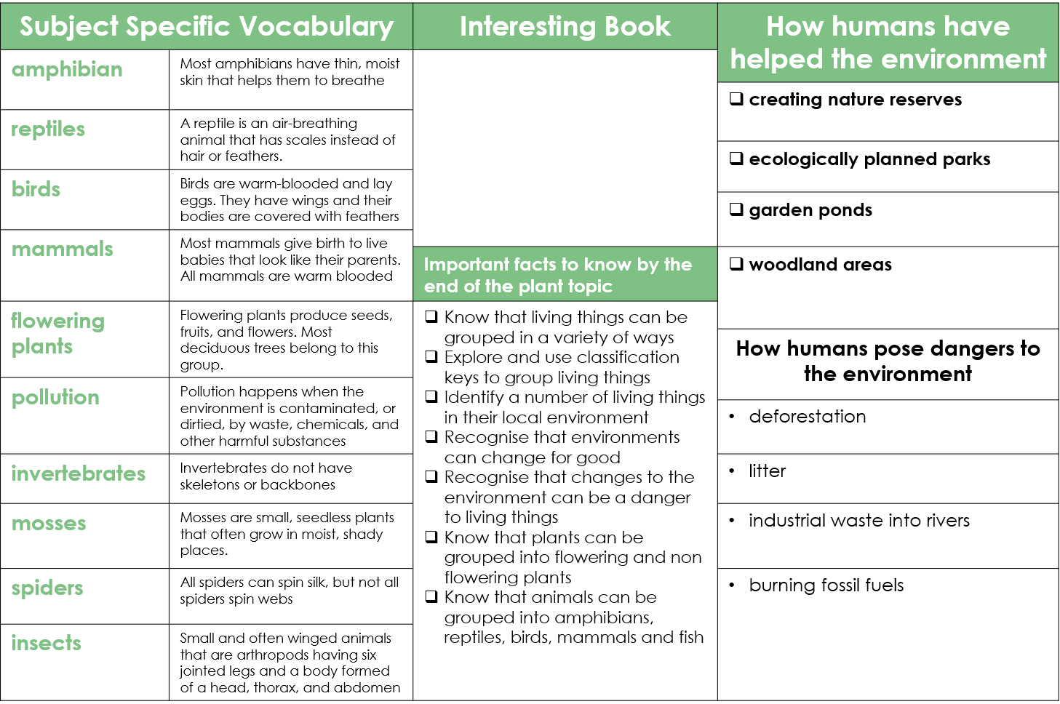
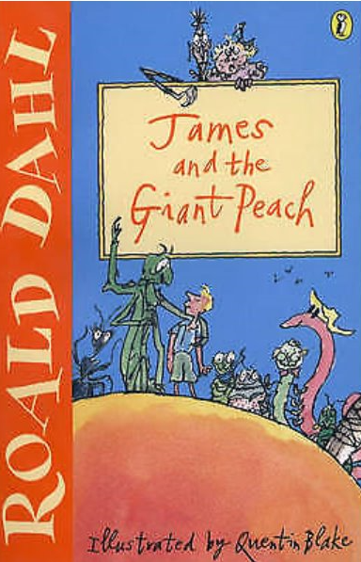
Year 4: Grouping Plants and Animals

Slide 4
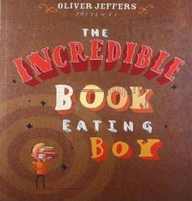
Year 4: Digestive System Knowledge Mat
Subject Specific Vocabulary |  | Interesting Book | Sticky Knowledge about the digestive system
pancreas | The pancreas produces juices called enzymes which help the body digest food.
 |  |  | The oesophagus is the food highway that takes your food from your mouth down into your stomach so that digestion can begin.
oesophagus | The oesophagus is like a stretchy tube that moves food from the back of the throat to the stomach.
intestine | The main function of the small intestine is absorption of nutrients and minerals from food. The major function of the large intestine is to absorb water from the remaining indigestible food. |  | The stomach is filled with powerful acids that break down the food into smaller pieces. It also lets us know when we are hungry.
 |  |  | The liver creates different enzymes to help process food nutrients that are collected in the small intestine.
organ | The skin is the biggest organ of your body. Other organs include your brain, lungs, heart, liver, stomach, intestines, pancreas, and kidneys, all called internal organs.
 |  |  | The gallbladder is a storage unit for all of the bile and enzymes created by the liver. It stores them until they are needed for digestion.
molars | Molars are the teeth that are used for chewing and grinding our food. |  | Animals like cockroaches are really important in a habitat—they eat the dead plants and recycle the nutrients back into the soil.
 |  | Important facts to know by the end of the digestive system topic:
canine | Canines are the teeth used for ripping and tearing our food. We have two located at the top of our mouth and two at the bottom.
 |  |  | The main job for the small intestine is to absorb nutrients and minerals from food. In fact, 90% of food absorption takes place here, making it our main digestion location.
 |  | Know and name the parts of the digestive system. Know the function of each organ of the digestive system. Know and identify the different types of teeth in humans. Know the function of different human teeth. Use food chains to identify producers, predators and prey. Construct food chains to identify producers, predators and prey.
food chain | A food chain is a diagram that shows us how animals are linked by what they eat.
 |  |  | The outside of our teeth are covered with enamel and the inside have blood vessels and nerves.
predators | Predators are wild animals that hunt, or prey on, other animals. Predatory animals need the flesh of the animals that they kill to survive.
 |  |  | The front teeth are called incisors, the four sharp teeth are called canines, the teeth at the back are called molars.
prey | The term prey refers to an animal that is sought, captured, and eaten by a predator.
salivary gland | The salivary glands contain special enzymes that help digest the starches in your food.

Slide 5
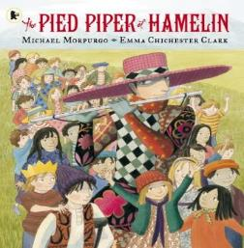
Year 4: Sound Knowledge Mat
Subject Specific Vocabulary |  | Interesting Book | Sticky Knowledge about Sound
vibrating | Sound is caused by the vibration of a medium (usually air) and it travels in waves.
 |  |  | Sound travels with a speed of 767 miles per hour but it cannot travel through a vacuum.
pitch | A high sound has a high pitch and a low sound has a low pitch. A tight drum skin gives a higher pitched sound than a loose drum skin.
 |  |  | Sound comes from vibrations. These vibrations create sound waves which move through mediums such as air and water before reaching our ears.
volume | Volume is the perception of loudness from the intensity of a sound wave. The higher the intensity of a sound, the louder it is perceived in our ears, and the higher volume it has.
 |  |  | Dogs can hear sounds at a higher frequency than humans.
insulation | Protecting something by surrounding it with material that reduces or prevents the transmission of sound.
 |  |  | Our ear drums vibrate in a similar way to the original source of the vibration, allowing us to hear many different sounds.
outer, middle and inner ear | The ear is made up of three different sections: the outer ear, the middle ear, and the inner ear. These parts all work together so you can hear and process sounds. | Important facts to know by the end of the sound topic:
 |  | Know how sound is made. Know how sound travels from the source to the ears. Know to associate sound with vibration. Know the correlation between pitch and the object producing a sound. Know the correlation between the volume of a sound and the strength of the vibrations that produced it. Know what happens to a sound as it travels away from its source. | When traveling through water, sound moves four times faster than when it travels through air.
cochlea | The cochlea looks like a spiral-shaped snail shell deep in your ear. It plays an important part in helping you hear.
 |  |  | Sound is used by many animals to detect danger, warning them of possible attacks before they happen.
auditory | Auditory is close in meaning to acoustic, but auditory usually refers more to hearing than to sound.
frequency | Frequency is measured as the number of wave cycles that occur in one second.
 |  |  | The loud noise you create by cracking a whip occurs because the tip is moving so fast it breaks the speed of sound!
hammer | The ear has little bones called ossicles that help you hear. They are called the hammer (malleus), anvil (incus), and stirrup (stapes). They amplify the sound or make it louder.

Slide 6
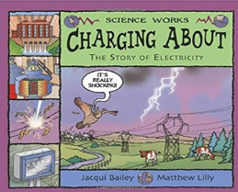
Year 4: Electricity Knowledge Mat
Subject Specific Vocabulary |  | Interesting Book | Sticky Knowledge about electricity
circuit | An electrical circuit is a completed path through which an electrical current flows.
 |  |  | Electricity can be generated by from power stations, wind, the sun, water and even animal poo!
buzzers | A buzzer is an automatic signalling device. They are used as alarms and door bells.
 |  |  | Electricity is a type of energy that can build up in one place to flow to another.
conductor | A conductor is an object or type of material that allows the flow of an electrical current in one or more directions
 |  |  | A power station is a place where electricity is created and sent to our homes.
battery | A battery is a device that stores chemical energy and makes it available in an electrical form.
 |  | Important facts to know by the end of the electricity topic in Year 4 | Electricity travels at the speed of light, which is more than 186,000 miles per hour.
cells | An electrical cell is a device that is used to generate electricity.
switch | A switch is an electrical component that can ‘make’ or ‘break’ an electrical circuit.
 |  |  | One flash of lightening could power 1000 houses for a whole year.
 |  | Know about common appliances that run on electricity. Know how to construct a simple series electrical circuit. Identify and name the basic parts of the circuit, including cells, wires, bulbs, switches and buzzers. Know that a switch opens and closes a circuit. Know about some common conductors and insulators. Know that metals are good conductors.
socket | Sockets allow electrical equipment to be connected to the alternating current (AC) power supply in buildings and at other sites.
 |  |  | When an electric charge builds up on the surface of an object it makes static electricity. This is why we sometimes have a small electric shock.
appliance | An electrical appliance is a device that uses electricity to perform a function.
 |  |  | The first power plant opened in 1882 and was opened by Thomas Edison.
appliance series circuit | Components connected in series are connected along a single path, so the same current flows through all of the components.
 |  |  | Thomas Edison was a very famous inventor who helped us make the most of electricity from bulbs to fuses.
insulator | An insulator is a material whose internal electric charges do not flow freely.

Slide 7
Year 4: Living things and their habitats
Subject Specific Vocabulary |  | Interesting Book | How humans have helped the environment
amphibian | Most amphibians have thin, moist skin that helps them to breathe
reptiles | A reptile is an air-breathing animal that has scales instead of hair or feathers.
 |  |  | Creating nature reserves
 |  |  | Ecologically planned parks
birds | Birds are warm-blooded and lay eggs. They have wings and their bodies are covered with feathers
 |  |  | Garden ponds
mammals | Most mammals give birth to live babies that look like their parents. All mammals are warm blooded | Important facts to know by the end of the plant topic | Woodland areas
 |  |  | How humans pose dangers to the environment
flowering plants | Flowering plants produce seeds, fruits, and flowers. Most deciduous trees belong to this group. | Know that living things can be grouped in a variety of ways. Explore and use classification keys to group living things. Identify a number of living things in their local environment. Recognise that environments can change for good. Recognise that changes to the environment can be a danger to living things. Know that plants can be grouped into flowering and non flowering plants. Know that animals can be grouped into amphibians, reptiles, birds, mammals and fish.
 |  |  | Deforestation
pollution | Pollution happens when the environment is contaminated, or dirtied, by waste, chemicals, and other harmful substances
 |  |  | Litter
invertebrates | Invertebrates do not have skeletons or backbones
mosses | Mosses are small, seedless plants that often grow in moist, shady places.
 |  |  | Industrial waste into rivers
spiders | All spiders can spin silk, but not all spiders spin webs
 |  |  | Burning fossil fuels
insects | Small and often winged animals that are arthropods having six jointed legs and a body formed of a head, thorax, and abdomen

