Slide 1
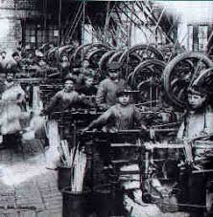
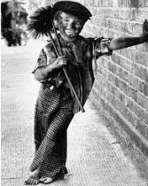
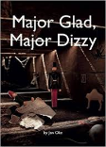
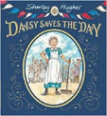
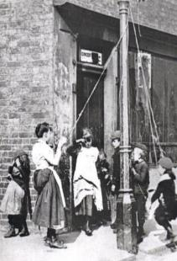
Beyond Living Memory: KS1 Knowledge Mat
Subject Specific Vocabulary for the Victorian Period |  |  | Exciting Books
gramophone | A gramophone is an old type of record player. A gramophone plays records.
wireless | The earliest form of radios. The word radio replaced wireless around the 1920s.
quilt | A quilt is the name given to a warm and heavy covering put on a bed. Today we use a duvet.
penny farthing | This was one of the earliest bicycles. It had one large and one small wheel. | Sticky Knowledge about history beyond living memory
farthing | A farthing was a coin. It was worth a quarter of an old penny. Four farthings made an old penny.
 |  | Workhouses were unpleasant places where orphaned children or abandoned children lived. It was also the home to mentally ill or very poor people.
washing dolly | A washing dolly was historically a tool used for tossing laundry by pumping the dolly up and down on the laundry in the dolly tub.
 |  | There were no televisions or electronic games 100 years ago. There were very few books as well and very few poor children would know how to read.
charabanc | A type of horse-drawn vehicle or early motor coach, usually open-topped.
 |  | About 100 years ago most children would have been working in a full-time job by the time they were 12 years old.
workhouse | This was the home to many orphaned or sick children. It was also home to poor people without a job.
 |  | The most popular games played by children 100 years ago were marbles, hopscotch, blind man’s bluff and blow football.
gruel | Gruel is a food consisting of some type of cereal—oat, wheat or rye flour, or rice—boiled in water or milk.
 |  | Over a 100 years ago there would not have been any take-away food places. However, fish and chip shops first opened about 150 years ago.

Slide 2
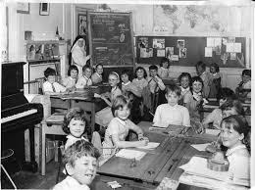
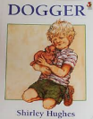
Within Living Memory: KS1 Knowledge Mat
Subject Specific Vocabulary |  |  | Exciting Books
blackboard | A blackboard would be seen in almost every classroom in the 1960s. Today we have screens or an interactive whiteboard.
chalk | Chalk was used by teachers to write on the blackboard. It was mainly white but there many colours of chalk.
nit nurse | The name given to the nurse who came to school to check hair for lice.
inkwell | Many desks had a hole in the top right hand corner for ink. This was known as the inkwell. | Sticky Knowledge about history within living memory | Popular TV programmes in the 1960s
pen and nib | In most schools children used pens and ink to write. The pens had a nib at the end which was replaced from time to time. | The Beatles became a world famous pop group. The four members of the group came from Liverpool and their music is still very popular today. | Jackanory The Flowerpot Men Thunderbirds Crackerjack Lassie
skipping | A very popular game in the 1960s. It was a long piece of rope which was turned by two children. | The England football team won the World Cup in 1966. It is the only time England has won it. The final was played at Wembley in London.
 |  | It was very rare for people to go to a restaurant in the 1960s. ‘Meat and two veg’ was a common term to describe a roast meat meal. Prawn cocktail started to be eaten as a starter.
marbles | Another popular game was marbles. Many children came to school with a pocketful of marbles.
snakes and ladders | A board game which everyone knew in the 1960s. The board was made up of squares and you would move up a ladder and down the snake. | Fashion changed greatly in the 1960s. After the war people didn’t have money to spend of clothes but that changed in the 1960s with colourful, hippie- style clothes being very popular.
ludo | Another very popular board game. It was played with a dice. Children would chase each other around the board. | The mini car was very fashionable in the 1960s. The best selling cars were Ford Anglia; Vauxhall Viva; Morris Minor and the Ford Corsair.

