Slide 1
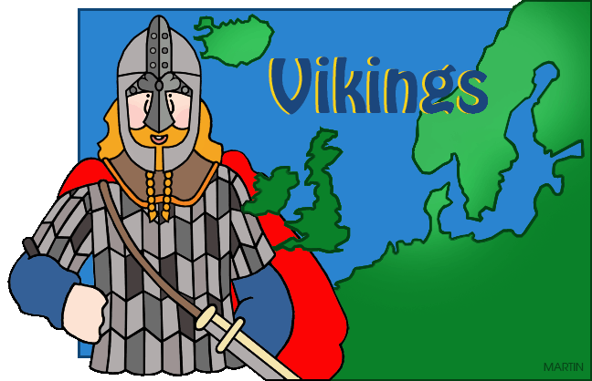
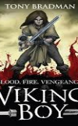
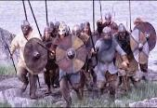
Vikings: KS2 Knowledge Mat
Subject Specific Vocabulary |  |  | Exciting Books
archaeologist | People who discover our history by looking at artefacts that have been found.
raids | A sudden armed attack with the aim of causing damage rather than occupying any of the enemy's land.
vicious | To be intentionally harmful or nasty. Vikings warriors were known to be vicious.
longhouse | A large hall-like building where many Viking families would live together. | Sticky Knowledge about the Vikings | Days of the week
berserkers | Warriors that went to war wearing wolf or bear skins. They were out of control and charged fearlessly. The word ‘berserk’ came from it. |  | The names for most of the days of the week originate from Vikings.
 |  | Not all Vikings were warriors. Many came in peace and become farmers.
 |  |  | Monday – linked to the moon by the name Mani – Norse for Moon.
longship | The narrow boat used by Vikings to raid along coasts. | The lands that the Vikings occupied were known as Danelaw.
Odin | One of the most famous Viking Gods known for wisdom. |  | Tuesday named after the Viking God of War – Tyr.
 |  | No Vikings wore horns in their helmets.
Scandinavia | The name given to a collection of countries: Denmark, Norway and Sweden. | Vikings spoke Norse, which had an alphabet made up of runes. | Wednesday – named after Odin and known as Woden’s Day.
Danelaw | The name given to lands in Britain occupied by the Vikings. | Longships were designed to sail in both deep and shallow water so that they could get close to the shore and sail in rivers to get inland. | Thursday – named after Thor, the God of thunder.
misconception | This means mis-understanding. In Viking terms there were many misunderstandings about the Vikings.
 |  | Vikings were pagans and often raided monasteries, looting gold.
Jorvik | The Viking name for the city of York. York now has a famous Viking museum called Jorvik.
 |  | The most important Viking British city was York, or Jorvik as it was known by the Vikings.

Slide 2
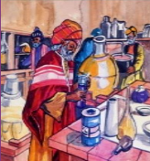
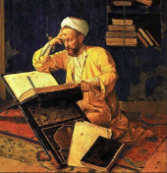
Islamic civilization: KS2 Knowledge Mat
Subject Specific Vocabulary |  |  | Exciting Books
Baghdad | Baghdad is today the capital of Iraq and was the capital of the Muslim world.
House of Wisdom | This was a library or university where scholars from all over the world were invited to study
mosque | A place where Muslims worship.
Ramadan | The most sacred month in the Islamic culture. Muslims do not eat or drink between dawn and dusk. | Sticky Knowledge about the Islamic civilization AD900
 |  |  | The House of Wisdom
scholar | A highly educated person.
 |  |  | The place where scholars were invited to record their knowledge in Arabic. All scholars were invited: Muslim, Jews and Christians. Knowledge of medicine, astrology and science were the main areas studied and shared. The knowledge was very advanced for its time, with cures for many serious ailments being discovered.
Prophet Muhammad | Muslims believe that Islam is a faith that has always existed and that it was gradually revealed to them by Muhammad. | The House of Wisdom housed a library and attracted scholars from around the world who translated texts from the classical world into Arabic.
merchant | A person or company involved in wholesale trade. | In 762, the newly-founded city of Baghdad became the capital of the Muslim world.
manuscript | A book, document or piece of music written by hand rather than typed or printed.
 |  | Until 1258, Baghdad was the world centre of culture and learning, with the period being known as the Golden Age of Islam.
ailments | An illness, typically a minor one. | Islamic scholars and inventors adopted the Hindi symbol for zero and style of numerals (1, 2, 3, 4, 5, etc.) which we still use today.
madrassa | A school built in, or alongside, a mosque.
crusades | The Crusades were a series of wars when Christians invaded the Muslim lands. | By the 8th century Islamic scholars were using paper rather than parchment or papyrus for their writing.

