Slide 1
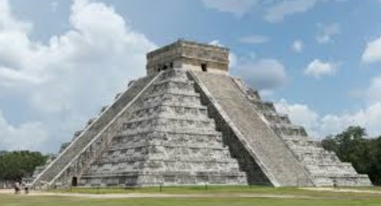
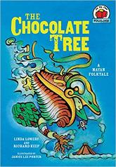
Mayan Civilisation: KS2 Knowledge Mat
Subject Specific Vocabulary |  | Each symbol represents a letter or sound | Exciting Books
glyphs | Symbols used in the Mayan writing system. Each symbol represents a word or sound.
codices | Books created by the Mayans. They were made of soft bark and folded like a fan.
Chichen Itza | The Mayans most well-known pyramid.
cacao | Seeds that the Maya used to make chocolate. | Sticky Knowledge about the Mayan civilization
ahau or ahaw | The main king or lord of a Maya city-state.
 |  | The Mayans were expert mathematicians and astronomers. They used this expertise to make calendars.
batab | A lesser lord, usually ruling over a small town. | Although the Mayans had metal-working skills, metal ores were scarce. Mayans used stone tools to carve the limestone that they used for their buildings.
Itzamna | The main god of the Maya, Itzamna was the god of fire who created the Earth.
 |  | Mayan religion was extremely bloodthirsty, demanding human sacrifices and blood-letting rituals. The Mayans believed in an afterlife and that those who were sacrificed, as well as those killed in war and women who died in childbirth, went to ‘the place of misty sky’.
huipil | A traditional garment worn by Maya women.
Kin | Word representing a day in the Maya calendar. | At the top of Mayan society was the king and royal family who were believed to be closely linked to the gods. An educated elite of scribes, priests and nobles formed the ruling class. They occupied the finest buildings in the city.
Kukulcan | The serpent god of the Maya. One of the primary gods, especially to the Itza peoples of Chichen Itza.
Uinal | Word for a month in the Maya calendar. It was 20 days long. | Mayan society was formed of a number of city states each with their own ruler.
Mayans. The Mayan, or Maya, peoples made their home in an area known as Mesoamerica (modern day Mexico and Central America). Mayan culture was well established by 1000 BCE, and it lasted until 1697.

Slide 2
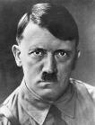
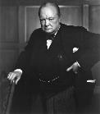
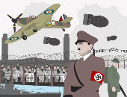
World War 2: KS2 Knowledge Mat
axis | Countries which fought on the German side including Italy, Germany and Japan.
Allies | Countries which fought on the British side (including: USA, Great Britain, France and Russia.
Nazi | Member of the German political group which came to power in 1933.
evacuation | Organised movement of children and the vulnerable from towns and cities to safe zones.
evacuee | Someone who was evacuated, moved from a danger area to a safer place.
Blitz | A series of bombing raids on the UK.
propaganda | Controlling news media (such as radio) to depict the war effort .
Holocaust | Murder of Jews and other groups of people by the Nazis.
Luftwaffe | The German Airforce.
RAF | The Royal Airforce (British).
refugees | A person who has been forced to leave their country in order to escape war.
Kindertransport | Transport arranged for Jewish children to flee German occupied countries.
War Timeline
1st September 1939 | In 1933, Adolf Hitler rose to power as the political leader of Germany. Germany invades Poland. Britain insists Germany withdraw troops from Poland. The Germans refuse. Britain declares war on 3rd Sep 1939. Britain initially responded with bombing raids over Germany.
1939 Onwards | Children were evacuated from cities expected to be bombed as enemy planes targeted factories etc. Children were evacuated to the countryside.
10th May 1940 | Chamberlain resigned and Winston Churchill was chosen to be his successor as Prime Minister on May 10, 1940.
June 1940 | Evacuation of Dunkirk. Large numbers of troops were surrounded by Germans at the French coastal town of Dunkirk. 338, 226 were saved by a fleet of 800 boats. This is known as the ‘Miracle of Dunkirk’.
6th June 1944 | D-Day. The Normandy landings were a series of landing operations by the Allies to claim Europe. It was the largest seaborne operation in history.
7th May 1945 | Germany surrenders: The Allies had forced the surrender of Axis troops in Europe. On 7th May 1945 Germany surrender to the Allies – the end of war in Europe.
8th May 1945 | VE Day. The VE in VE Day stands for Victory in Europe. It was the public holiday of 8th May 1945 to mark the defeat of Germany by the Allied forces in World War 2.
6th August 1945 | Atomic bomb dropped on Hiroshima. Japan refused to surrender, threatening to fight on. The US considered invasion but this would have led to deaths of 500,000. On the 9th Aug, the US dropped an atomic bomb on Nagasaki.
15th August 1945 | End of WW2 . The surrender of Japan was announced on August 15th 1945.
Sticky Knowledge
World War 2 was a battle between two groups of countries – the ‘Allies’ and the ‘Axis’. The major Allied powers were Britain, France, Russia, China and the United States. The major Axis powers were Germany, Italy and Japan.
Adolf Hitler, together with the Nazi Party, wanted Germany to rule Europe. To gain more land and power, on 1 September 1939 German troops invaded Poland. After Hitler refused to stop the invasion, Britain and France declared war on Germany – World War II had begun.
During the course of the war, German forces advanced through Europe. By the summer of 1941 they had invaded France, Belgium, Holland, Luxembourg, Denmark, Norway, Greece, Yugoslavia and the USSR.
Millions of Germans were imprisoned and killed because they didn’t fit the image of the ‘perfect’ German. Hitler wanted to create what he thought was the ‘best’ and strongest race – and to the Nazi Party, this excluded certain groups, such as Jews, Gypsies and those with physical and mental disabilities.
The group most heavily targeted by the Nazis were the Jews. Around six million Jewish people were killed during World War 2 in one of history’s most terrible events – the Holocaust. Racist in his views, Hitler blamed Jewish people for Germany losing World War I and claimed they were dangerous to German people and society.
The US didn’t join the war until 1941, when Japan attacked the United States at their Naval Base at Pearl Harbour in Hawaii. On 8 December 1941 (the very next day), the US declared War on Japan and, in turn, its German allies.
Some countries remained ‘neutral’ in World War 2. Such countries were Spain, Sweden and Switzerland – who chose not to join either side.
The Germans surrendered on 8 May 1945. In 1944, an Allied army crossed from Britain to free France from Nazi rule. One year later, Allied armies invaded Germany, forcing the Germans to surrender. After nuclear attacks on Japan’s major cities Hiroshima and Nagasaki, Japan also surrendered to Allied forces in August the same year. World War 2 had ended.

Slide 3
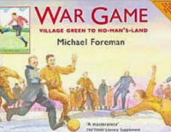
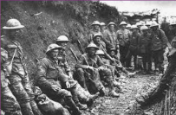
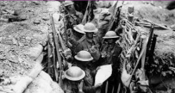
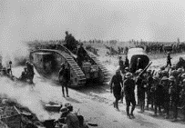
World War 1: KS2 Knowledge Mat
Subject Specific Vocabulary
trench | A long narrow ditch dug into the ground where soldiers lived
airships | Huge balloon like crafts used to carry out bombing raids in Britain.
 |  | Sticky Knowledge about World War 1
Archduke Franz Ferdinand of Austria | His assassination was believed to be the trigger to the outbreak of the WW1 war. He was heir to the Austro-Hungarian throne.
 |  | Aircraft were still very new in 1914, so when the Germans launched bombing raids on London, they were carried out from airships, known as zeppelins
Central Powers | The alliance of Germany, Austria, Hungary, Bulgaria and Turkey
 |  | In 1918 a pigeon, Cher Ami, one of about 100,000 homing pigeons used during the war, managed to save 500 US soldiers
front line | The trench closest to the enemy.
no man’s land | The area between the two sides during battle.
 |  | Tanks were developed by the British during the first world war
Battle of the Somme | The largest battle of WW1 and the bloodiest battle in history. | Before the war most women stayed at home or worked in domestic service
zeppelin | Giant German airships that carried out 52 air raids on Britain. | When the war started, British soldiers went into battle with just a cloth cap for protection
blackout | When lights from buildings, including houses, were not allowed to be seen from the sky. | Many people suffered facial injuries during the first world war
 |  | The first ever motorized ambulances were used during the first world war
Armistice Day | The day the agreement was signed between the Allies and Germany to end the war on 11th November.
 |  | Approximately 16,000 British conscientious objectors refused to fight during the war
conscription | A rule that said ALL healthy men aged 18 – 41 had to fight. | Due to food shortages, Britons were banned from throwing rice at weddings and feeding pigeons

Slide 4
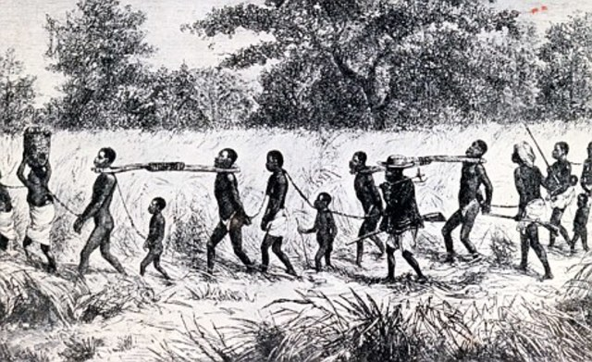
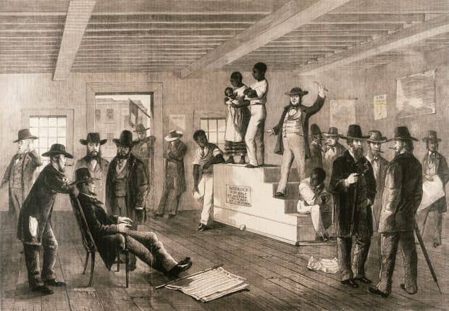
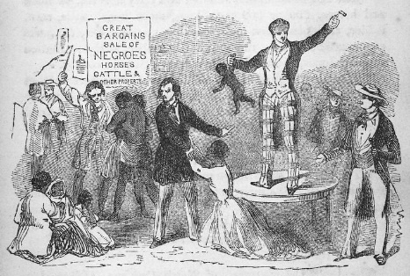
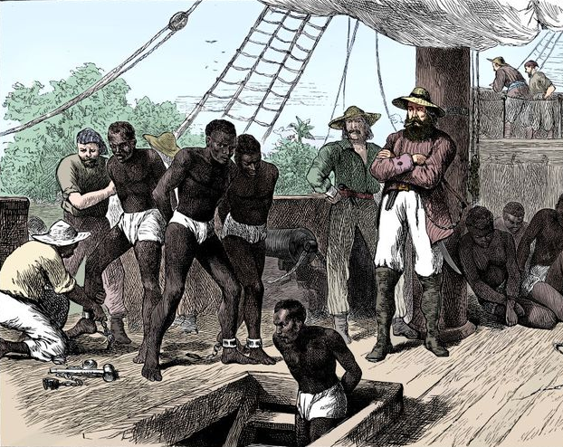
Slavery: KS2 Knowledge Mat
Subject Specific Vocabulary
slavery | Slavery is a system under which people are treated as property to be bought and sold, and are forced to work.
Slave auction | A gathering where slaves are bought and sold.
colonies | A country or area under the full or partial political control of another country and occupied by settlers from that country.
famine | A severe shortage of food (as through crop failure) resulting in violent hunger and starvation and death.
poverty | The state or condition of having little or no money, goods, or means of support; condition of being poor. | Sticky Knowledge about Slavery
Caribbean | The region consisting of the Caribbean Sea, its islands (including the West Indies), and the surrounding coasts. | know about Britain’s part in the slave trade
 |  | know what slave auctions were like
transportation | The movement of persons from place to place and the various means by which such movement is accomplished.
 |  | know about the horrific conditions on board slave ships
leg irons | A device, usually one of a pair of rings connected to a chain, that is attached to the ankles or feet to restrict movement.
 |  | know about the death rate during slaves’ transportation to America
dysentery | Infection of the intestines resulting in severe diarrhoea with the presence of blood and mucus in the faeces. | know that the majority of slaves came from Africa
transportation slave ship | A ship transporting slaves, especially one carrying slaves from Africa. | know what life was like for most of the slaves
William Wilberforce | A prominent campaigner for the abolition of the slave trade | know about the impact of slavery on the world today

