Slide 1
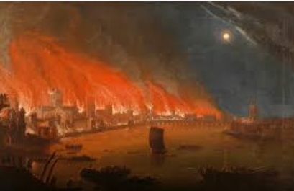
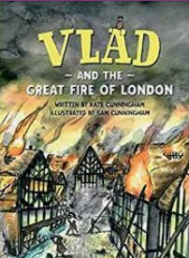
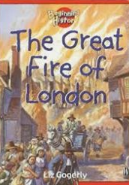
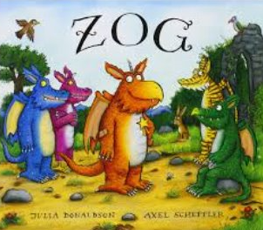
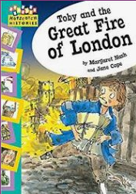
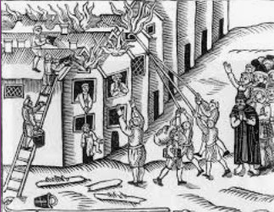
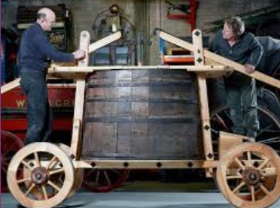
Beyond Living Memory: KS1 Knowledge Mat
Subject Specific Vocabulary for the Great Fire of London |  |  | Exciting Books
Stuarts | The Stuarts reigned from 1603 until 1714, more than a hundred years. At the time of the fire King Charles the second was king.
Pudding Lane | This street where the fire started was called Pudding Lane. A bakery in Pudding Lane was responsible for starting the fire.
plague | The plague is a terrible disease that is sometimes known as the Black Death. 1665 was the last time there was a major plague in England.
flea | Fleas were one of the main reasons why the plague could spread from person to person. They are small inspects that sting you. | Sticky Knowledge about history beyond living memory
Samuel Pepys | Samuel Pepys is famous for writing a diary which included the time the Great fire was raging through London. | Know that fire spread very quickly because the houses were built very close to each other and made of wood.
bakery | The bakery in Pudding Lane is where it all began. Thomas Farynor, the owner, said he had put out the fires in the ovens before he left the bakery. | Know that London was infested by rats and that they were responsible for the plague.
 |  | Know that the type of fire appliances used in those days could not cope with the fire.
Thames | The river that runs through London and where the fire fighters and the people trying to put out the fire got their water from. The Thames was where many people went to get away from the fire.
 |  | Know that the fire lasted for 4 days and destroyed large areas of London, making thousands of people homeless.
Thomas Farynor | Thomas Farynor was the owner of the bakery. He was also King Charles 11nd baker. | Know that a famous man called Samuel Pepys kept a diary of the events and that is one of the reasons we know about what happened.
drought | Before the fire started there had been a 10 month drought in London so everything was very dry when the fire started.
 |  | Know that the fire started in a bakery in Pudding Lane in London.

Slide 2
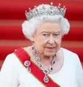
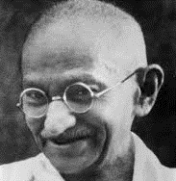
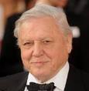
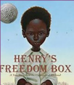
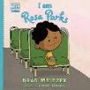
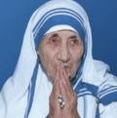
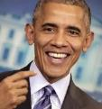
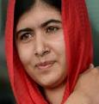
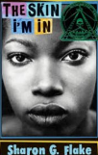
Famous people : KS1 Knowledge Mat
Subject Specific Vocabulary |  |  | Exciting Books
discrimination | Unfair treatment of people because of their colour, age religion, disability or sex.
disability | A physical or mental condition that limits a person's movements, senses, or activities.
famous | Someone who is known about by many people.
racism | Treating someone unfairly because of the belief that their race, religion or beliefs are not as good as yours. | Sticky Knowledge about Famous people
 |  | Rosa Parks fought for the rights of black people in the USA. She became very well-known for not giving up her seat to a white person on a bus.
chronological | Arranging something by the order they occurred in time.
 |  |  | More famous British people to find out about
inclusion | To include someone within your group however different they may seem. | Nelson Mandela fought for the rights of black people in South Africa. He became very famous in the end for his determination to protest non-violently.
 |  |  | Grace Darling William Shakespeare Charles Dickens John Lennon Elizabeth the First Sir Isaac Newton
protest | To take action to show disapproval or objection to something. | Emmeline Pankhurst was born in Manchester and spent her life fighting for women’s rights and equality. She is credited with helping women to have the right to vote.
equality | Equality is about ensuring that every individual has an equal opportunity to make the most of their lives and talents.
 |  | Florence Nightingale was known as ‘the lady with the lamp’. She helped to ensure that hospitals were clean places and helped to reduce infections in hospitals.
courageous | If you are a courageous person, you face danger or stand up against the odds without flinching.
 |  | Malala Yousafzai was shot because she stood up for the right of women and girls to receive education in Afghanistan.

